Slide 1
GitHub
Project Managment Tool

Slide 2
GitHub In Project Management
GitHub contains a lot of powerful options to manage your projects. Here are what we will talk about:
Issues:
What are issues
How to create
Prioritization
Assigning issues to members
Managing Workflow
Milestones
Pull Requests:
What is a pull request
How to create
Manage project merges
Code review

Slide 3
Issues
01
Issues are a powerful tool
for tracking your workflow

Slide 4
Issues
What are issues used for ?
Report issues regarding bugs, code problems, missing documentation or any other problem
Opening issues regarding necessary new features
Prioritizing tasks
Open discussions about an issue and its progress
Track your project progress
And many more!

Slide 5
Issues
Tracking
Prioritize
Stay Up-To-Date
Assignees
Issues let you track your work on GitHub.
Issues let you organize and prioritize your work with projects
You can comment and subscribe to issues to stay up-to-date
You can assign members to different issues to manage workflow

Slide 6
Issues Example
Example for an issue with our workshop project:
Labels of the issue. Helps the prioritization and organization
Assignees responsible for fixing the issue
Issue: Cannot add an item to guests carts

Slide 7
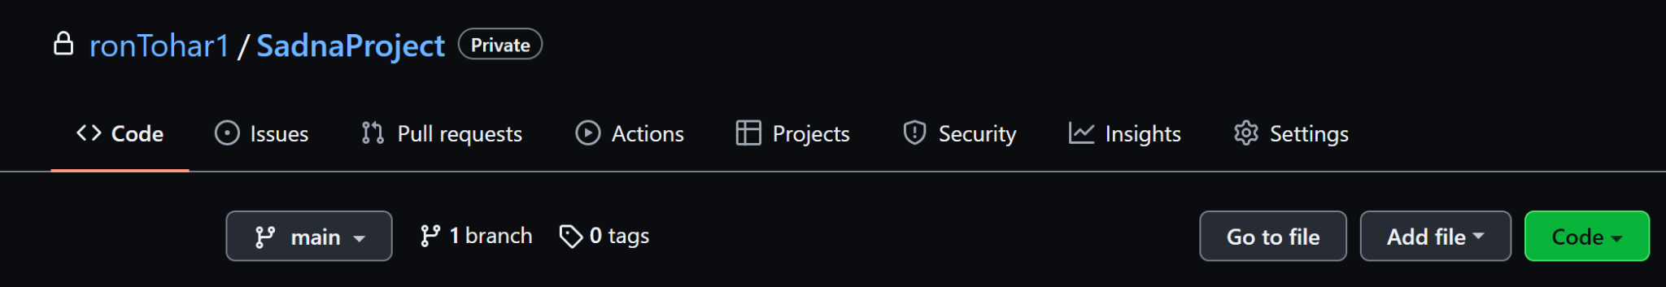
Creating A New Issue

Slide 8
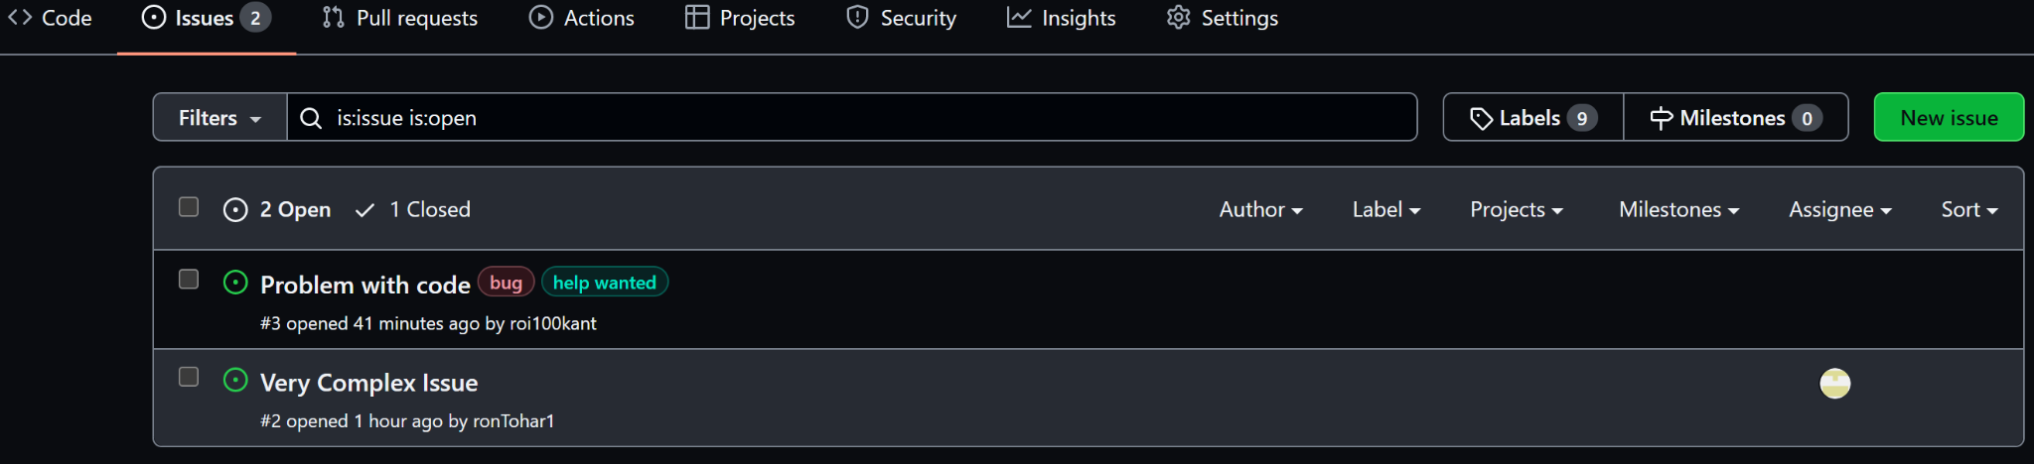
Creating A New Issue
List of open issues

Slide 9
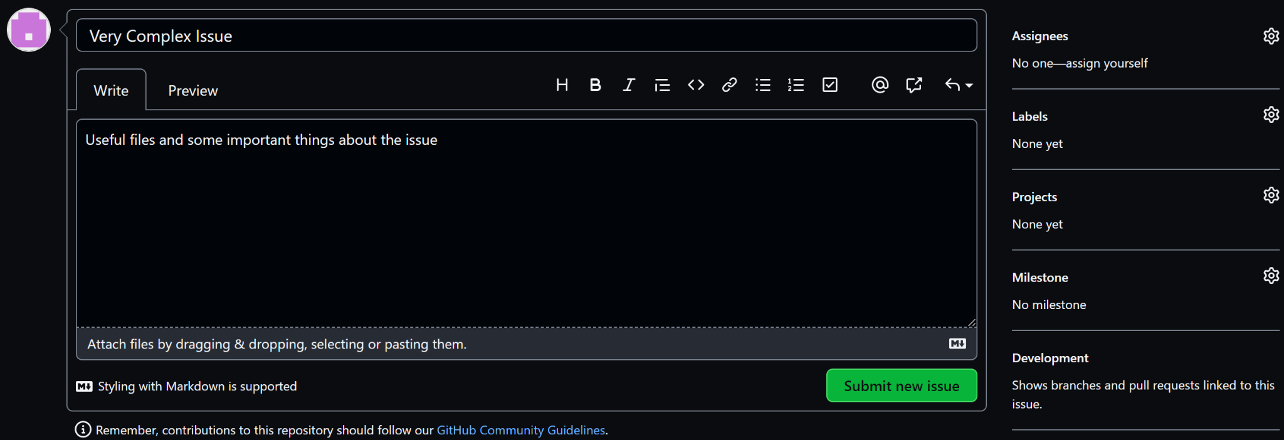
Creating A New Issue
Assign members to the issue
The name of the issue
Add comments and useful information
Prioritize issue with labels

Slide 10
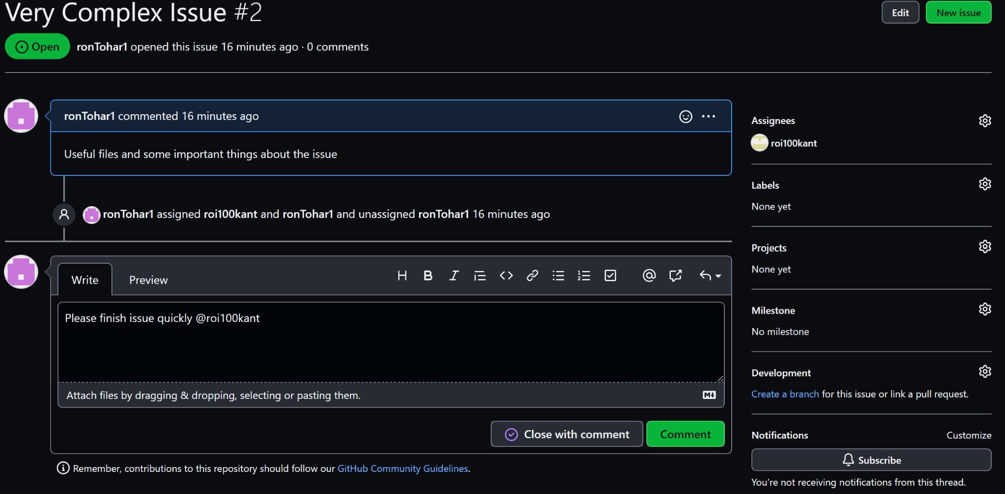
Commenting And Tracking
Issue Assignees
Write a comment
Subscribe to the issue

Slide 11
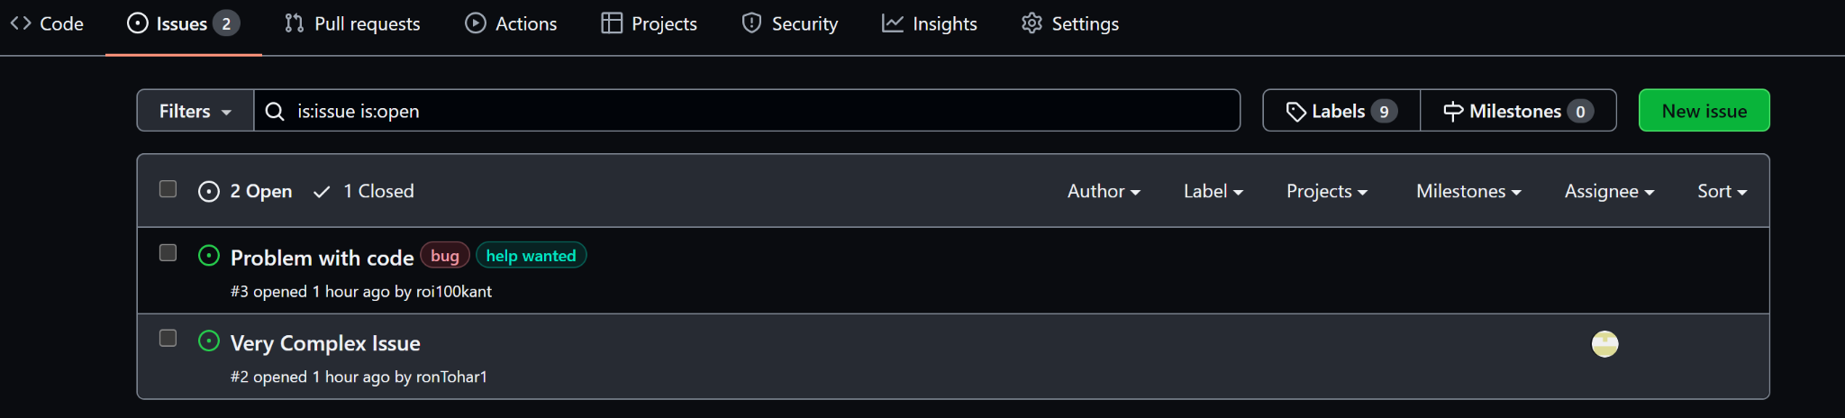
Prioritizing with labels
Labels of the issue

Slide 12
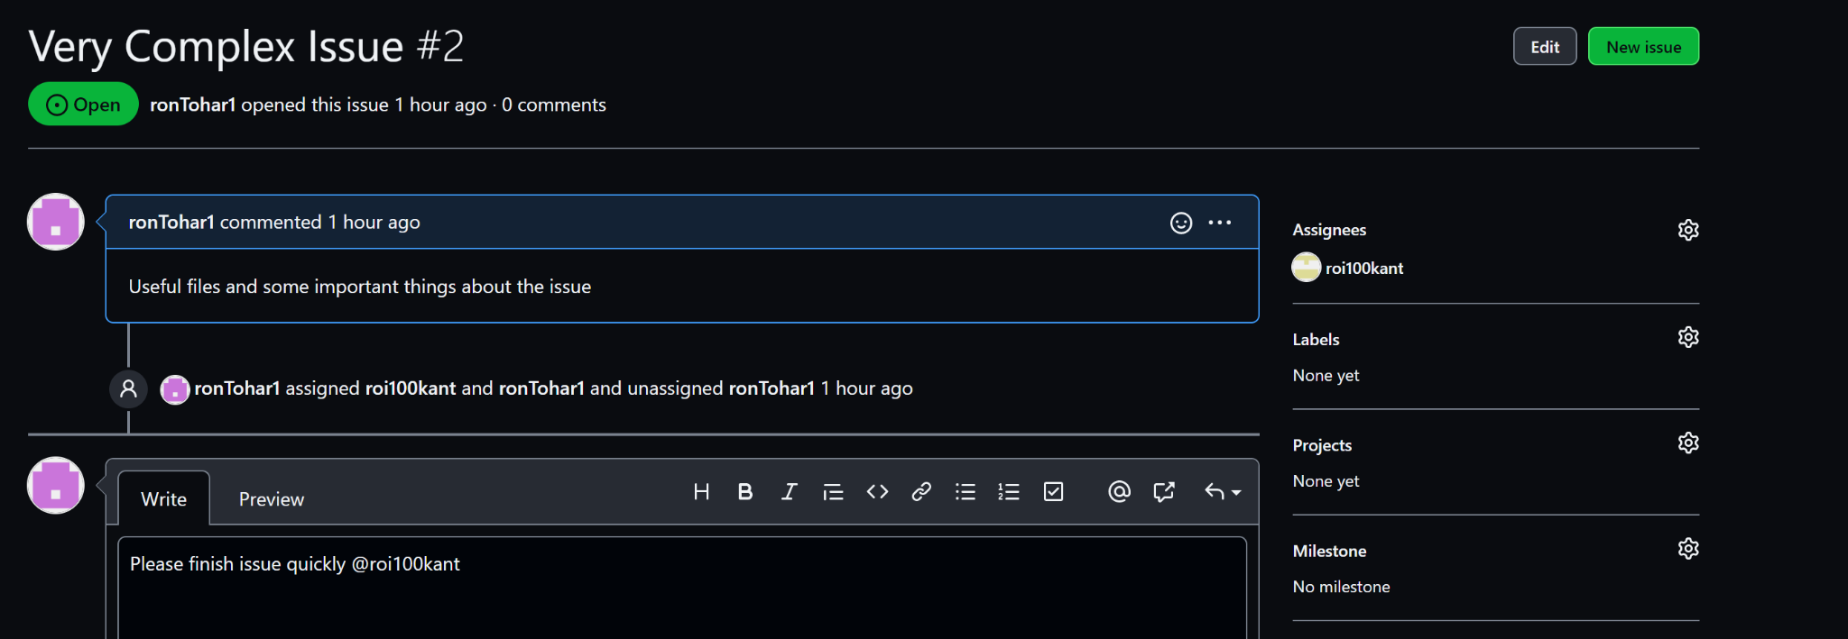
Assigning Label To Issue
Subscribe to the issue

Slide 13
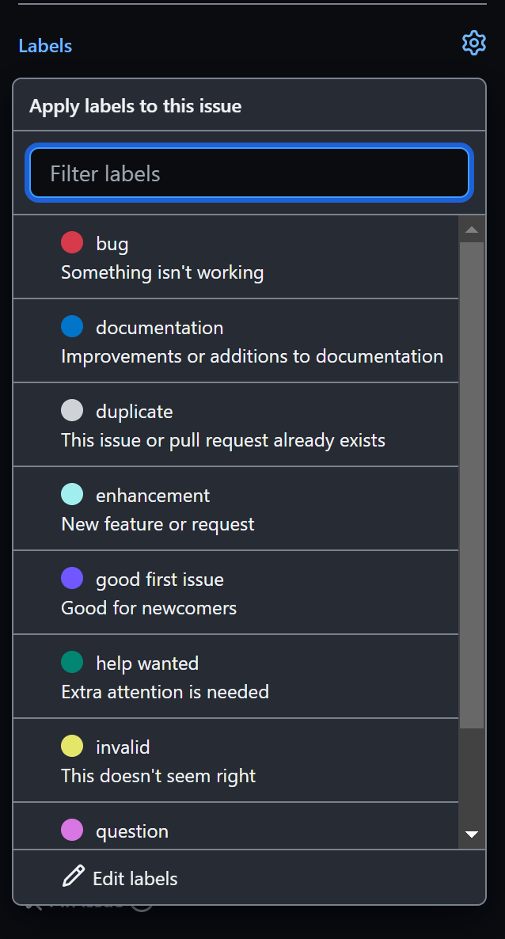
Assigning Label To Issue
Choose any label that suits the Issue

Slide 14
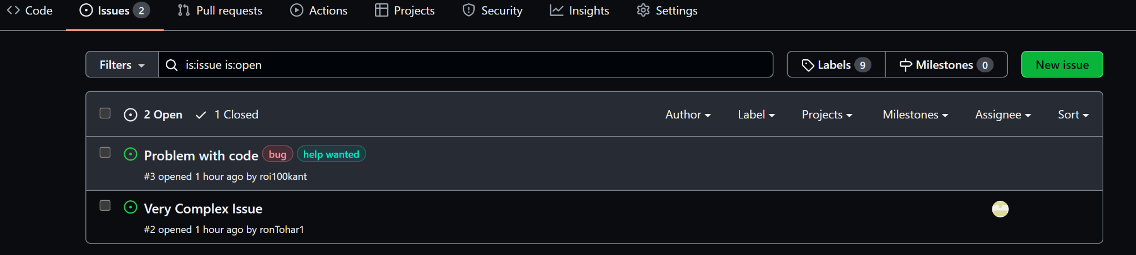
Creating New Labels

Slide 15
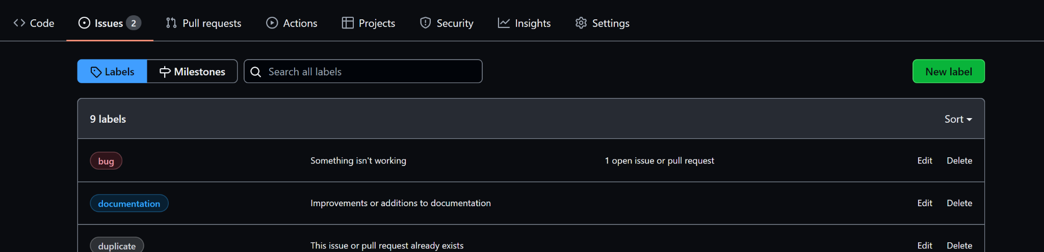
Creating New Labels

Slide 16
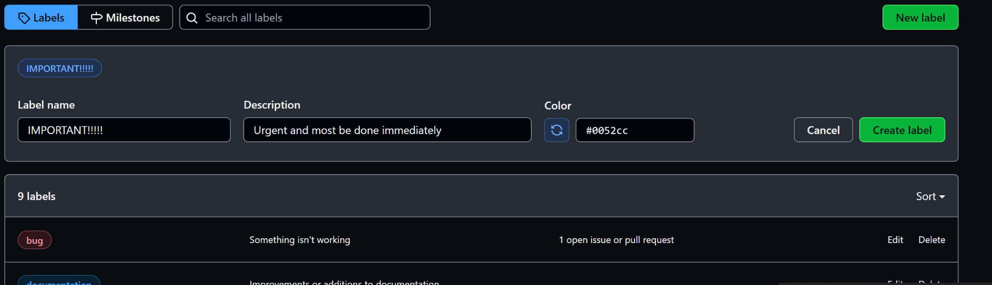
Creating New Labels

Slide 17
Milestones
Used for creating short or long term goals
Great for tracking your progress
Let you track each milestones progress
Are made of small Issues for better progress

Slide 18
Creating A New Milestone

Slide 19
Creating A New Milestone

Slide 20
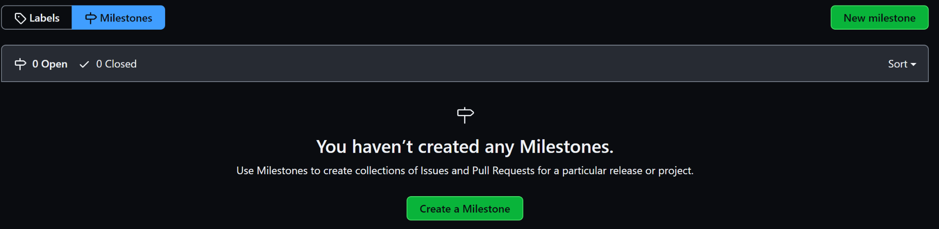
Creating A New Milestone

Slide 21
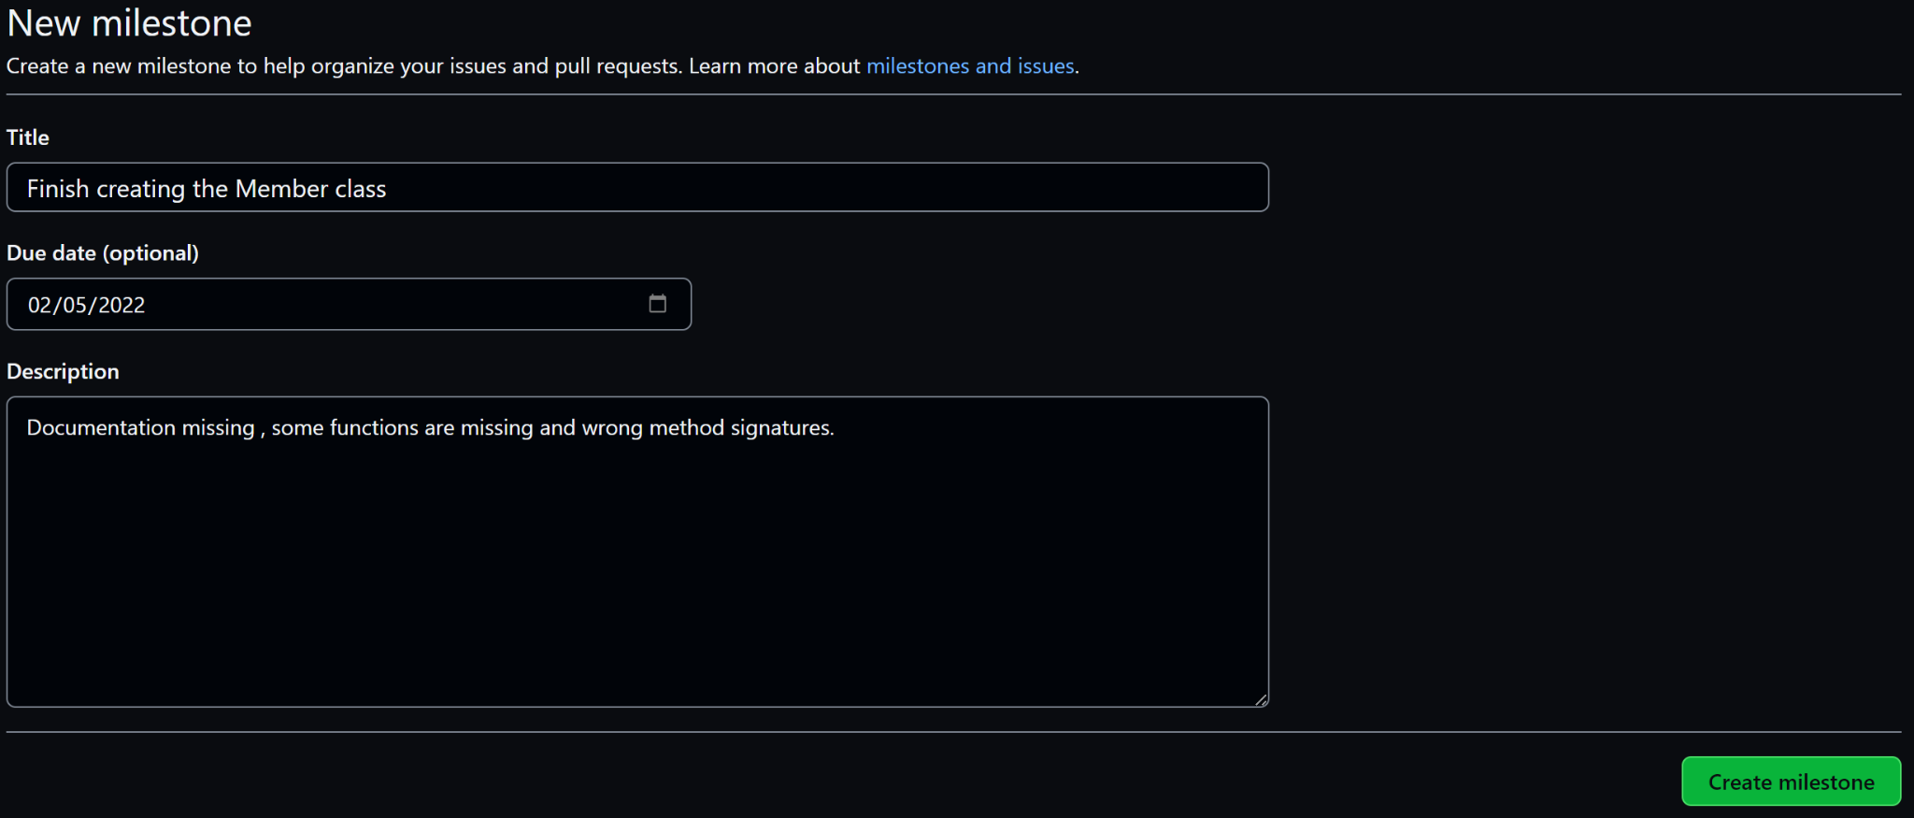
Creating A New Milestone

Slide 22
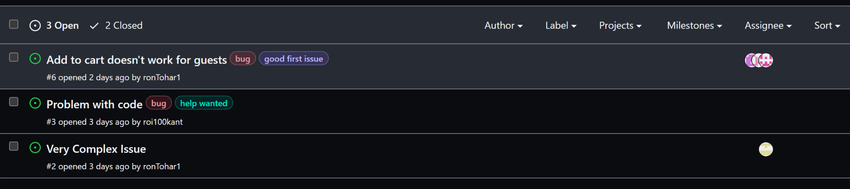
Associating Issues With Milestones
Choose an issue from the list of issues

Slide 23
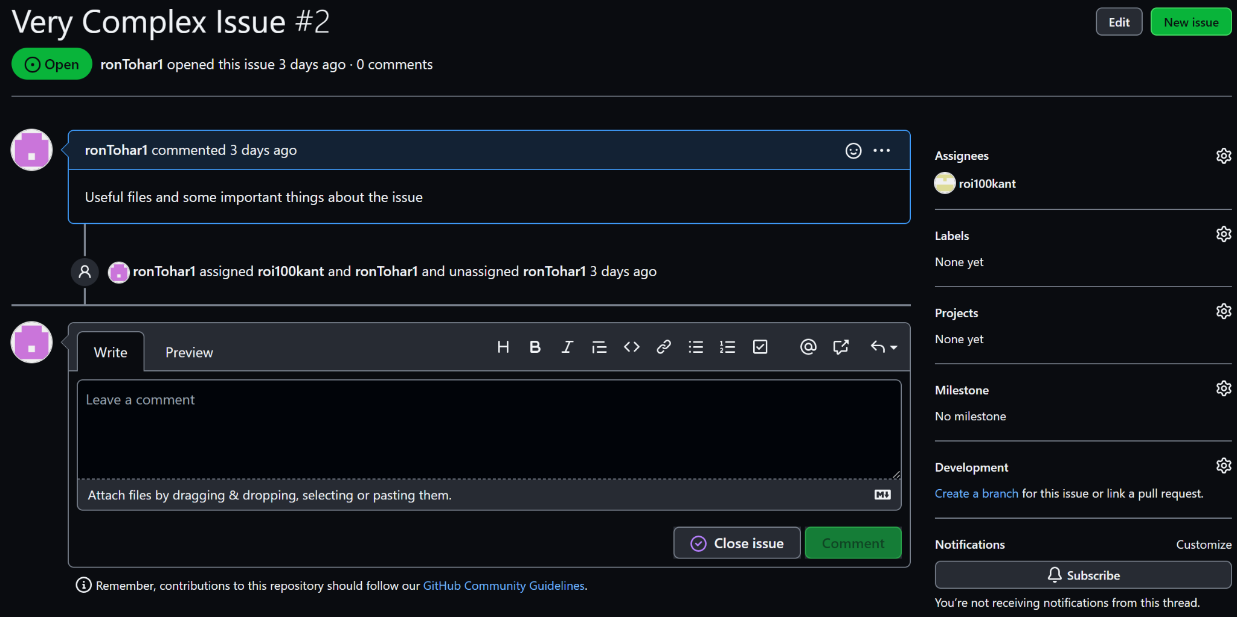
Associating Issues With Milestones

Slide 24
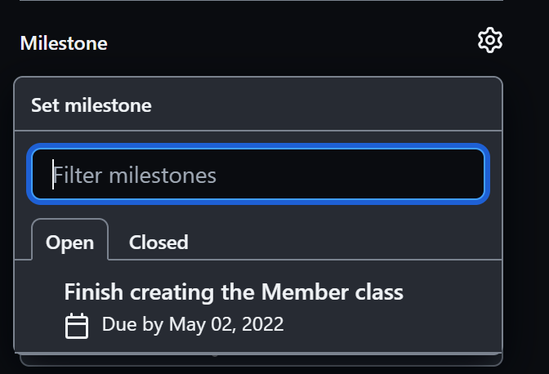
Associating Issues With Milestones

Slide 25
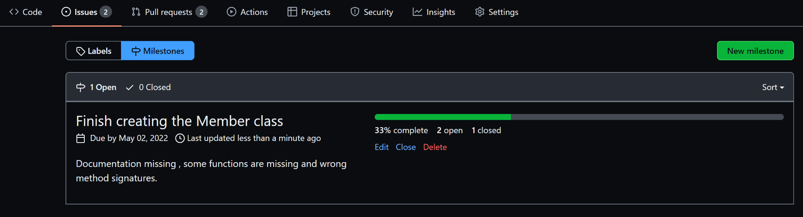
Tracking Milestones Progress
In the list of milestones you can track each milestone progress

Slide 26
More About Issues
For more useful information regarding issues refer the link below:
Tracking Your Work With Issues

Slide 27
Pull Requests
02
Pull Requests let you discuss and finalize changes that are being pushed

Slide 28
Pull Requests
Are a way of asking to merge a work branch into a base branch
Let you tell others about changes you pushed to a branch
Allows comparing and discussing the changes before merging the branch
Allows others to add follow-up commits before merging the changes to the base-branch
Are great for managing code changes!!

Slide 29
Pull Requests
Review changes
Control Changes
Comparison Tool
Pull Requests let you review and discuss changes commited.
Pull Requests allow the group to decide together if a change should be merged or declined.
Pull Requests are a great tool for visualizing the changes made and comparing them

Slide 30
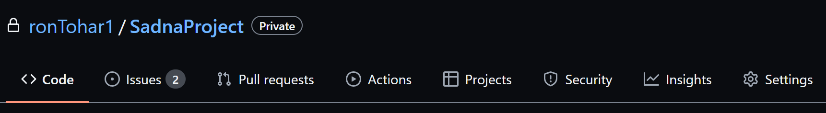
Creating Pull Requests

Slide 31
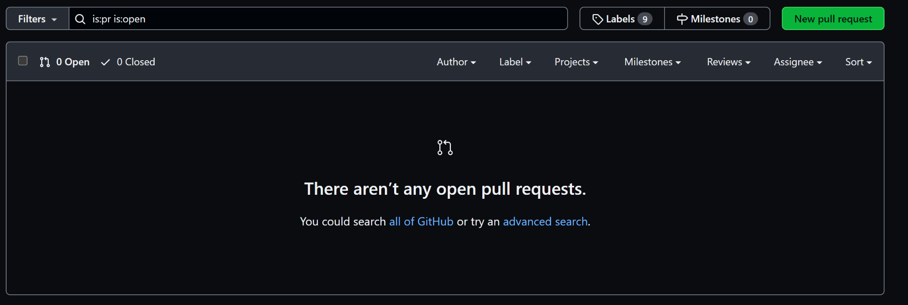
Creating Pull Requests

Slide 32
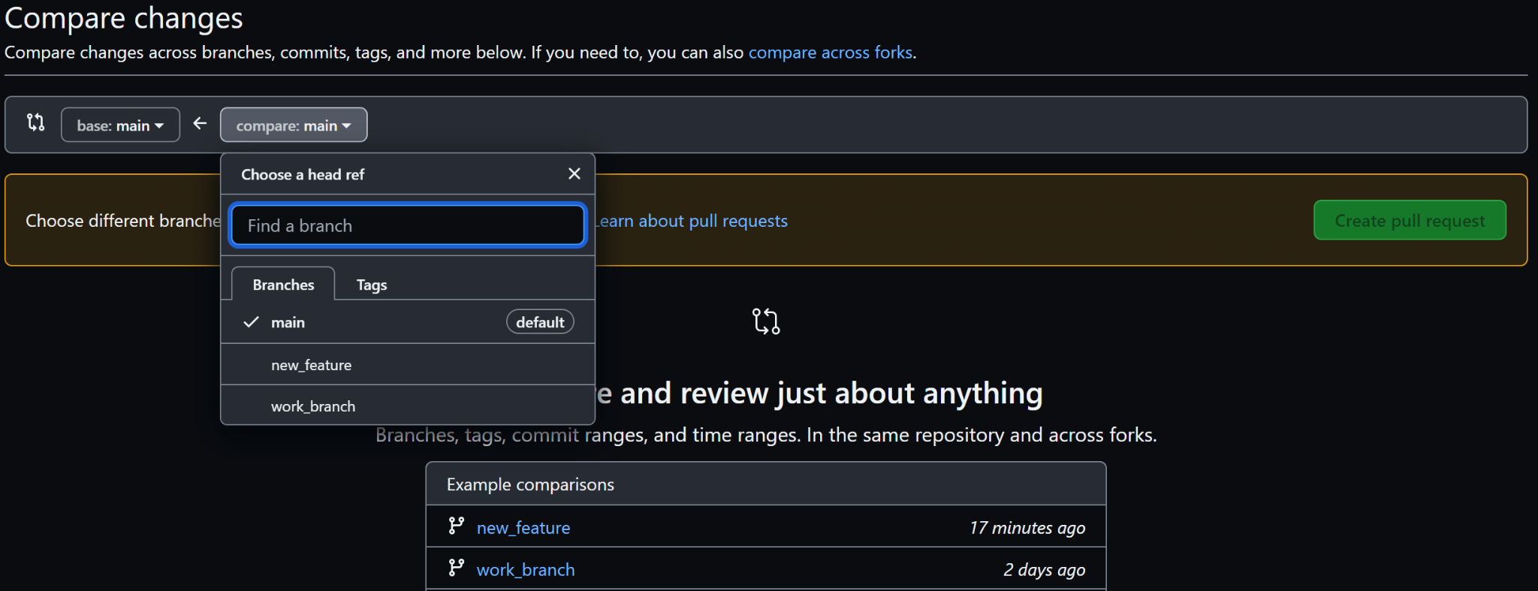
Creating Pull Requests
Choose the base branch
Choose the branch to merge

Slide 33
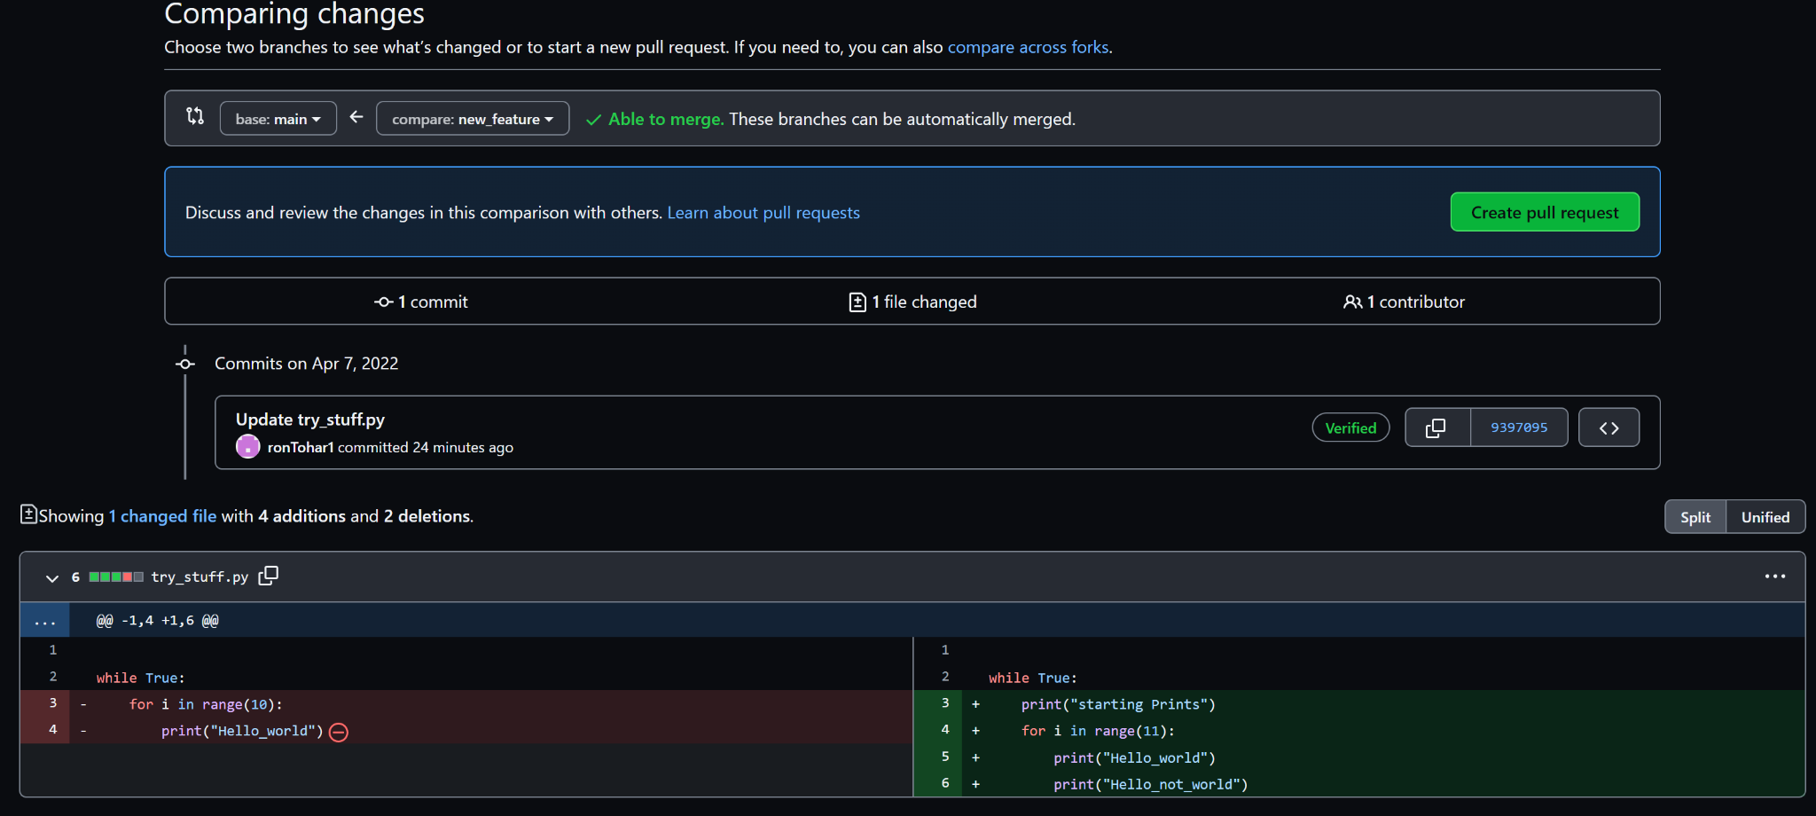
Creating Pull Requests
Comparison of changes

Slide 34
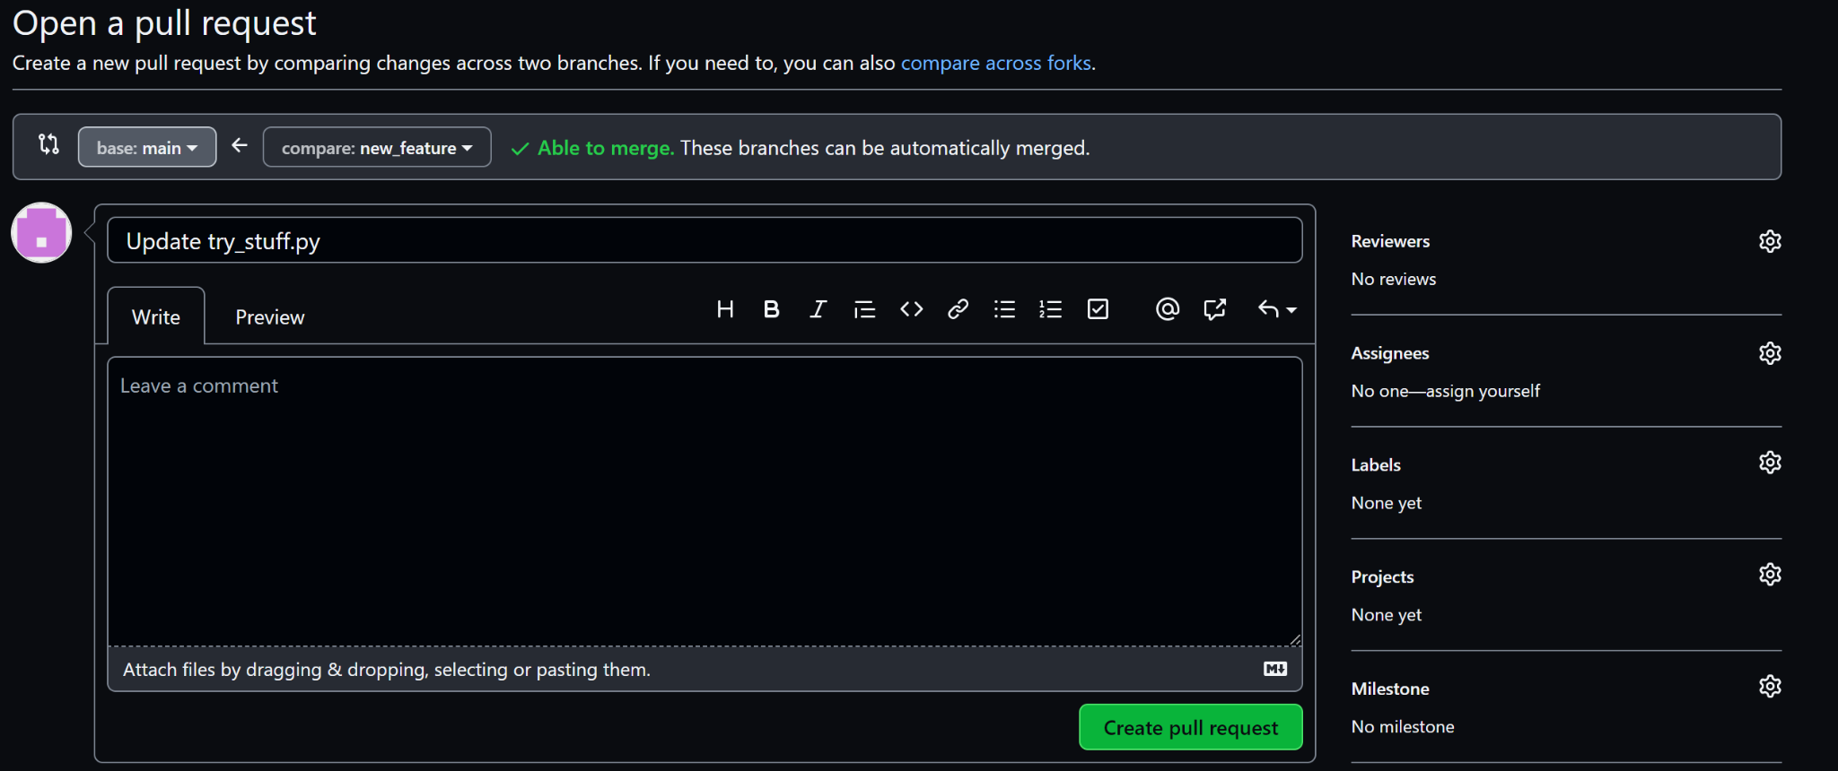
Creating Pull Requests
requesting project members to review the pull request
Title of the pull request
Assign members that also work on that pull requests

Slide 35
Pull requests

Slide 36
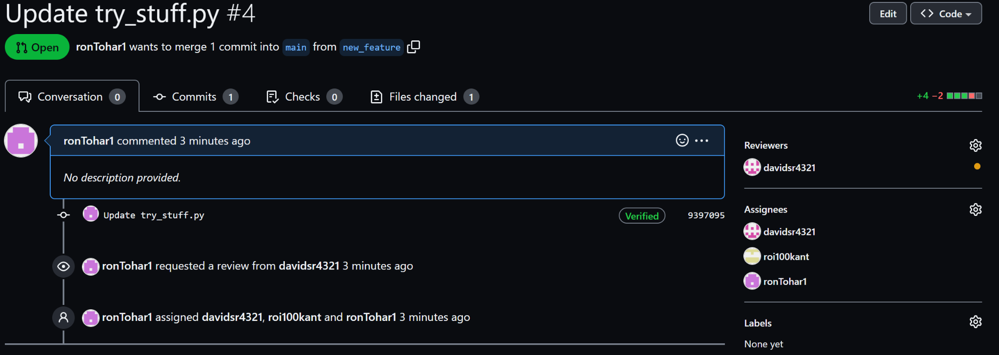
Pull requests
Discussions about the pull request
All files added, deleted and changed
Commits in branch
Tracking the pull request flow

Slide 37
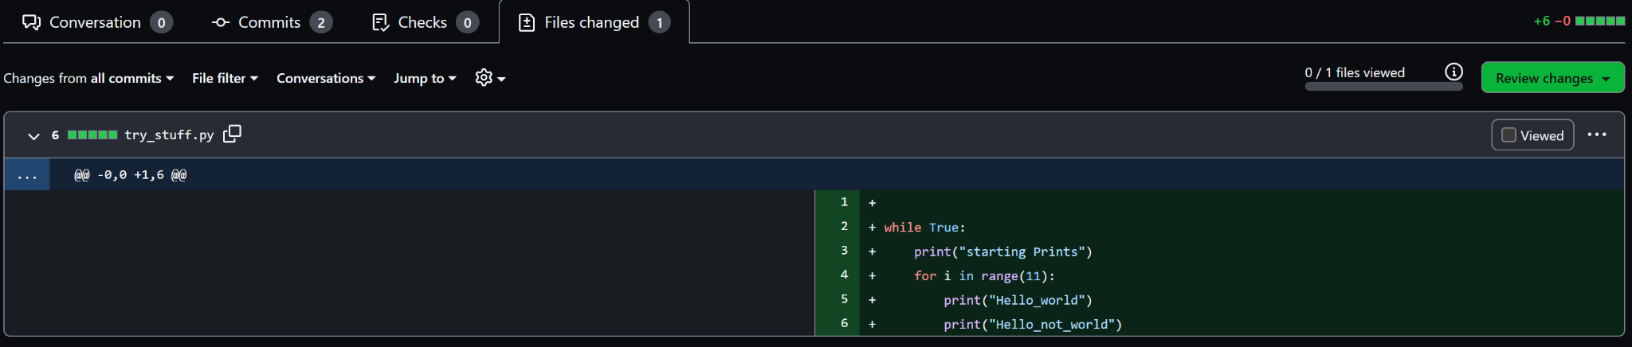
Reviewing Pull requests
Reviewing changes

Slide 38
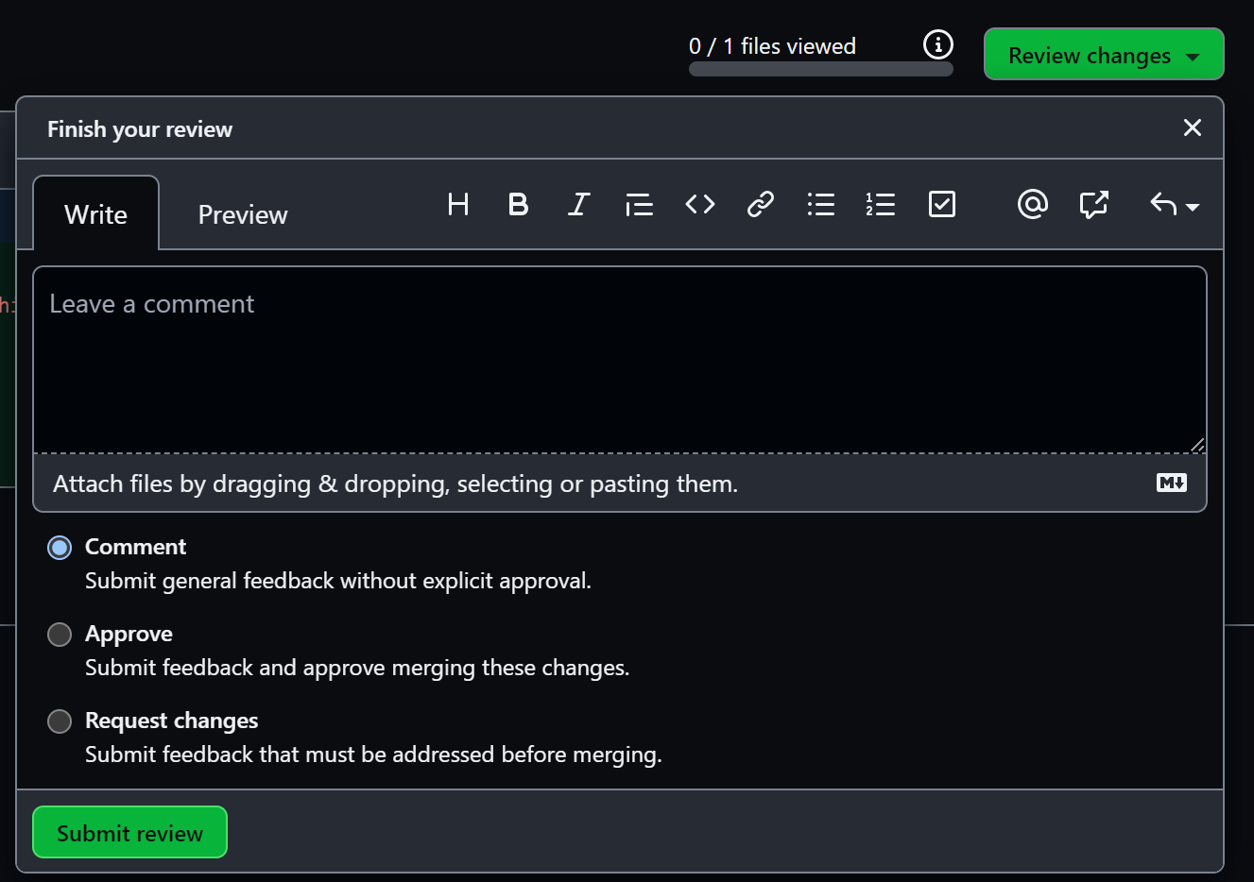
Reviewing Pull requests
Choose an option when reviewing the changes

Slide 39
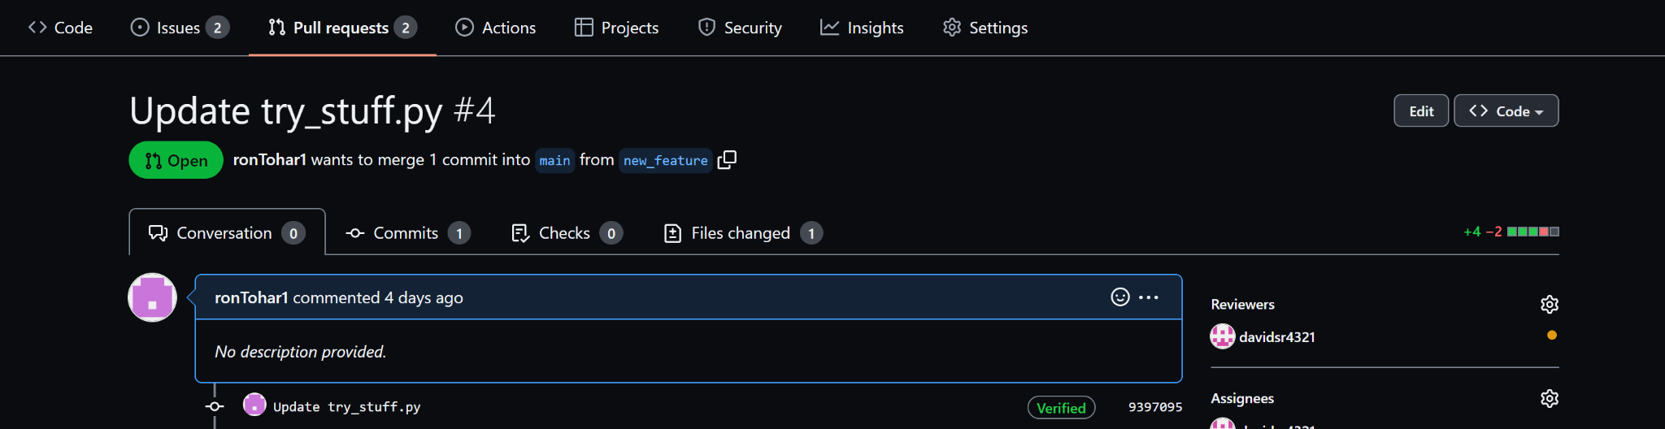
Declining Pull requests

Slide 40
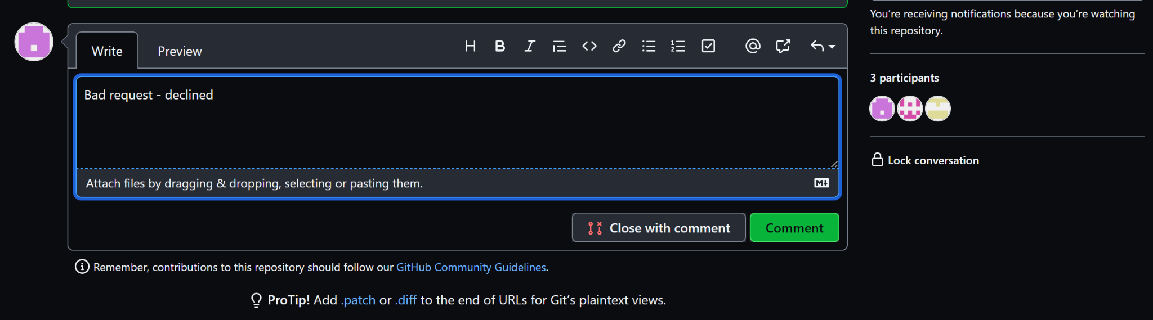
Declining Pull requests
Add a comment

Slide 41
Approving Pull requests

Slide 42
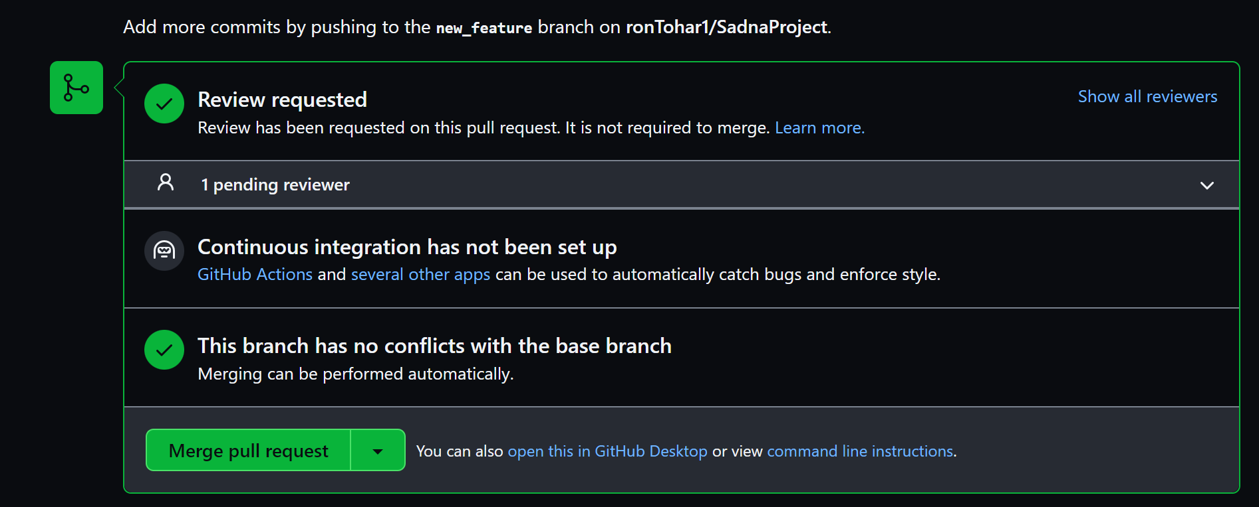
Approving Pull requests

Slide 43
Conclusion
Assign issues between group members for better time and project management
Prioritize and categorize problems and tasks
Create milestones in order to set short and long term goals
Track your progress easily and visually
Changes must be applied and managed with “Pull Requests”
All changes are discussed, reviewed and approved before being applied
GitHub is a great project management tool which allows for optimal workflow and tasks management

Slide 44

GitHub Project Management
All you need is Hub

